Slide 1
Urban Data Disaggregation Using Graph Attention Networks

Slide 2
Introduction
Motivation
some urban data are released at highly aggregated level (potentially due to privacy concerns)
Concern
Using aggregated data in urban computing can mask important local hotspots and overlook the spatial variations and city dynamics.
Goal:
to parse down aggregated urban data into spatial units at finer-resolution.

Slide 3
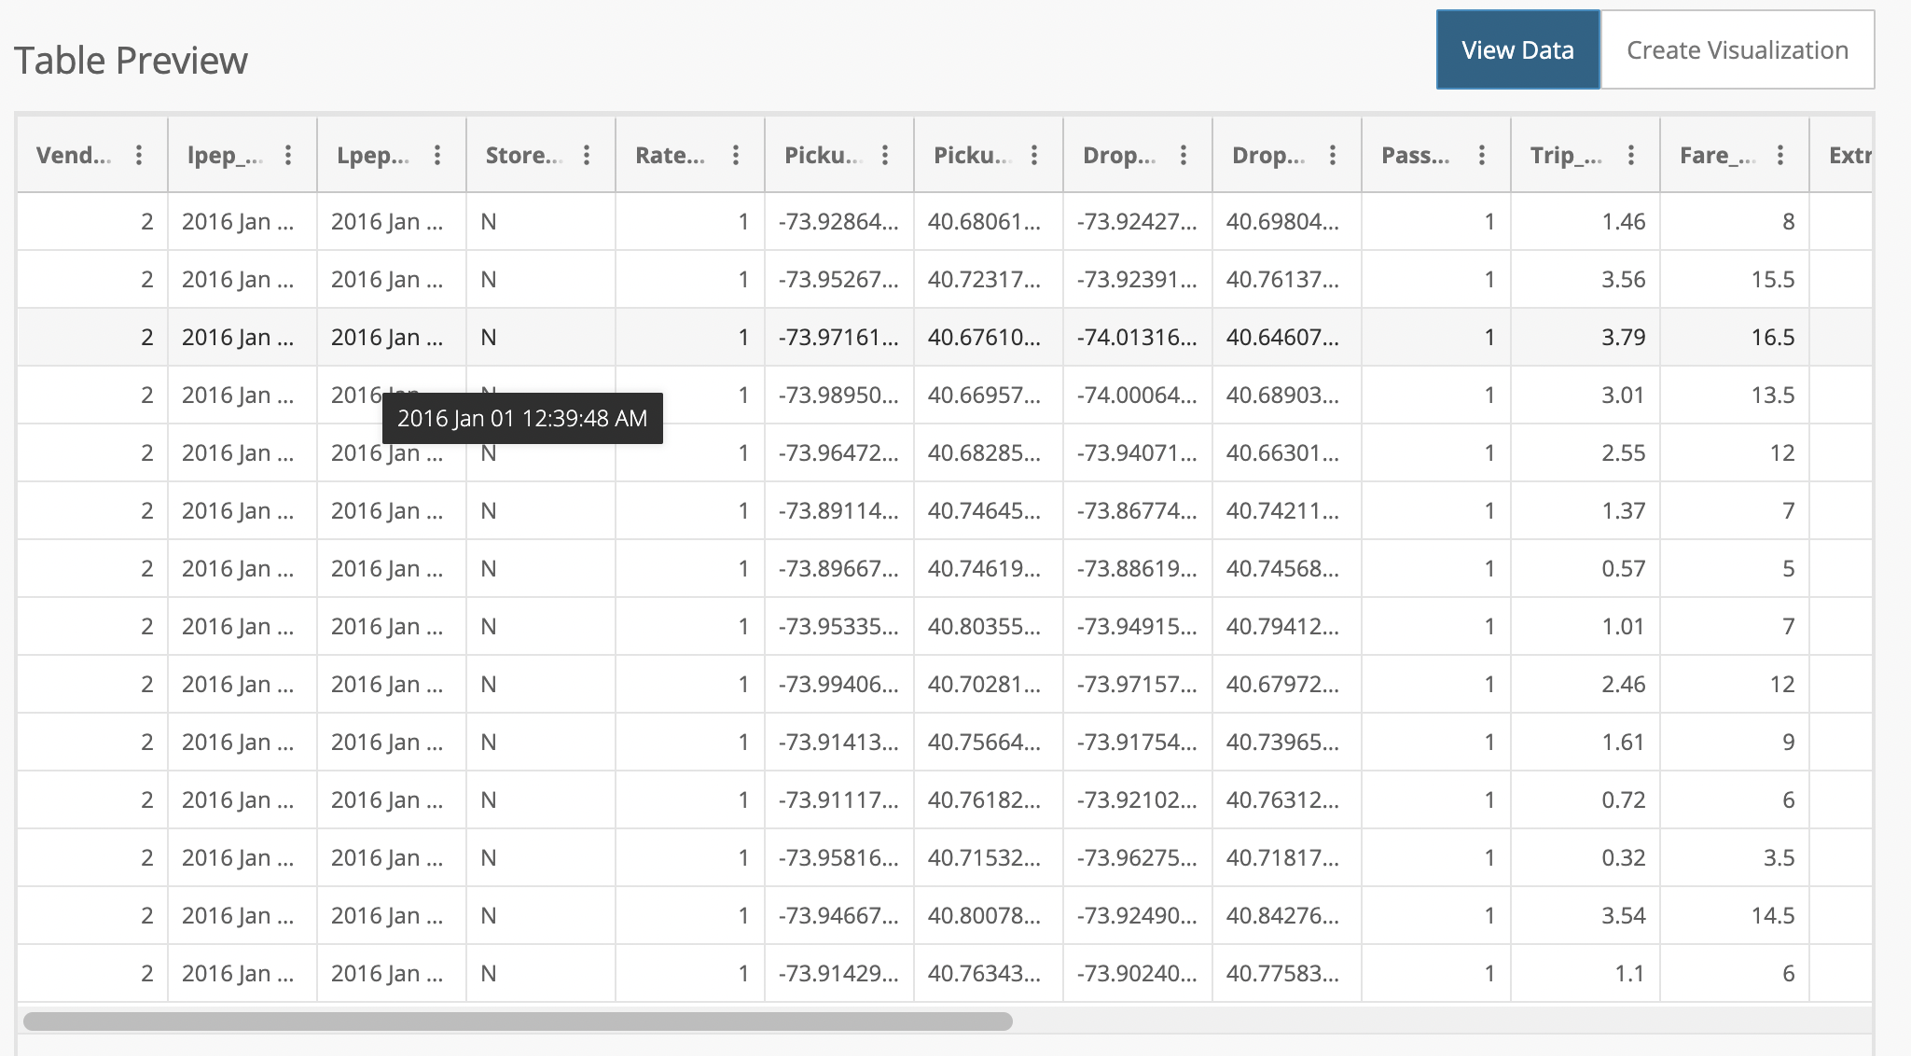
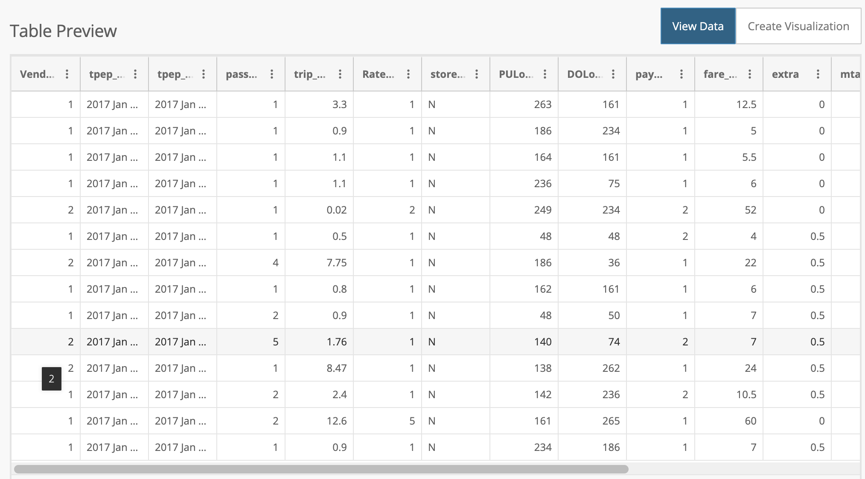

Introduction
2016 NYC Yellow Taxi Data
2017 NYC Yellow Taxi Data

Slide 4
Introduction
Motivation
some urban data are released at highly aggregated level (potentially due to privacy concerns)
Concern
Using aggregated data in urban computing can mask important local hotspots and overlook the spatial variations and city dynamics.
Goal:
to break the aggregated urban data into spatial units at finer-resolution.

Slide 5
Related Work – Spatial Disaggregation
Mass-preserving areal weighting
Disaggregation is distributed uniformly across its area.
Areal interpolation
Estimate unknown data points for specific locations using known data values in other locations.
Dasymetric mapping
(most popular)
Dasymetric weighting schemes extend this idea of distributing the known population of an area by creating a weighted surface to distribute the known population, instead of doing so uniformly.

Slide 6
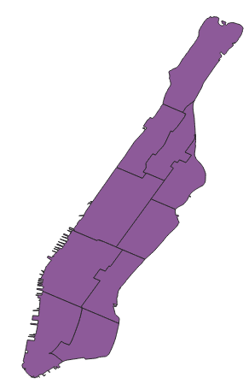
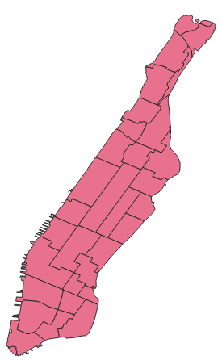
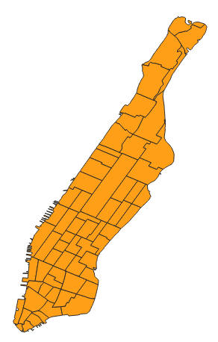
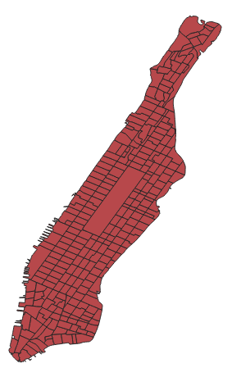
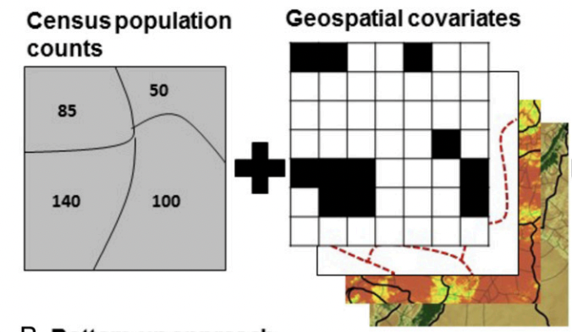
Related Work – Concerns of Dasymetric Mapping
Grid Representations
Convenient, but could be inaccurate – hard to be aligned with pre-defined & irregular geospatial units.
Graphs can better represent the adjacent geospatial units.
Reliance on external variables
Commonly used variables: land type; water/land marks; slope; rainfall etc.
urban dynamics change fast; hard to find supplementary variables that are fast-changing.
Public use microdata areas (pumas)
Neighborhood Tabulation Areas (NTAs)
Taxi Zones
Census Tracts

Slide 7
Proposal
Spatial Disaggregation
Extreme disaggregation
Data Fusion

Slide 8
Spatial Disaggregation
Mass-Preserving
Neural Networks
Graph Attention Networks

Slide 9
Spatial Disaggregation – Setting
A
1
A
1
B
D
3
B
2
C
2
E
C
3
D
E

Slide 10
Spatial Disaggregation – Mass-Preserving
Mass-Preserving:
Calculate the average disaggregation ratio from the source to the target regions based on training data.
1
A
D
3
B
2
E
C
A
1
B
2
C
3
D
E

Slide 11
Spatial Disaggregation – Mass-Preserving
Mass-Preserving:
Calculate the average disaggregation ratio from the source to the target regions based on training data.
1
A
D
3
B
2
E
C
A
1.0
A
1
B
0.3
1
B
2
C
0.7
2
C
3
D
0.28
3
D
E
0.72
E

Slide 12
Spatial Disaggregation – Neural Networks
Neural Networks:
2-layer shallow neural networks to disaggregate from source to target regions.
1
A
D
3
B
2
E
C
A
1
B
2
C
3
D
E

Slide 13
Spatial Disaggregation – Neural Networks
Neural Networks:
2-layer shallow neural networks disaggregating from source to target regions.
1
A
D
3
B
2
E
C
A
1
B
W1
W2
2
C
3
D
E

Slide 14
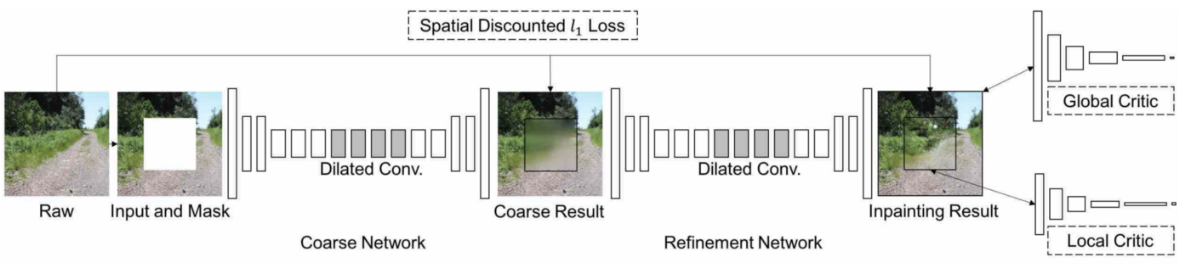
Spatial Disaggregation – GAN
Graph Attention Networks:
Inspired by Coarse-to-Fine pipeline that is frequently used in computer vision (image inpainting; super-resolution) and question answering.
1
A
D
3
B
2
E
C
A
1
B
2
C
3
D
E

Slide 15
Spatial Disaggregation – GAN
Graph Attention Networks:
Neural Networks
Coarse disaggregation – only mode the connections between source to target regions.
GAN
Fine disaggregation – further adjust the disaggregation values from coarse networks by modeling the connections/relationships among the target regions.
1
A
D
3
B
2
E
C
A
1
B
W1
W2
GAN
2
C
3
D
E
Coarse
Fine

Slide 16
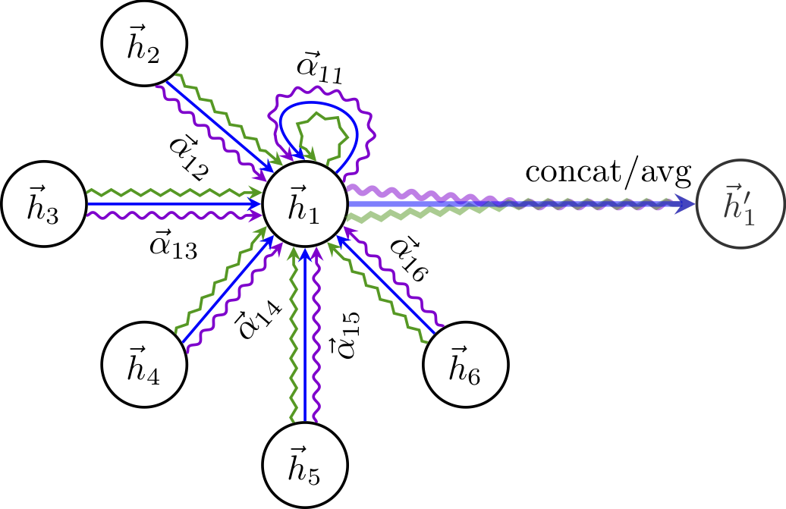
Spatial Disaggregation – GAN
Graph attention network is a spatial graph method – consider the adjacent neighbors of each unit, and aggregate values from adjacent neighbors in some ways.
A
A
D
0.18
D
0.12
B
0.34
B
E
0.27
0.09
E
C
C

Slide 17
Spatial Disaggregation – Data
2015 & 2016 NYC hourly taxi trip counts within each geospatial units
Four spatial levels: PUMA, NTA, Tract, Block
L1 loss as the evaluation metric
Public use microdata areas (pumas)
Neighborhood Tabulation Areas (NTAs)
Tracts Zones
Census Blocks

Slide 18
Spatial Disaggregation – Results
model | puma-nta | puma-tract | puma-block | nta-tract | nta-block | tract-block
Mass-preserving | 56.42548 | 13.67109 | 1.874034 | 11.87357 | 1.803625 | 1.534195
NN | 27.14701 | 7.911909 | 1.571177 | 6.72269 | 1.437877 | 1.310518
GAN | 26.28119 | 7.276273 | 2.010089 | 6.373247 | 1.663927 | 1.32951
GAN not well-trained?

Slide 19
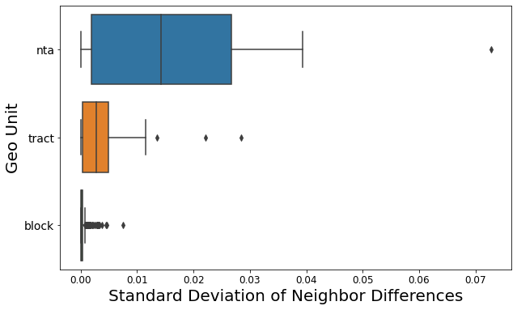
Spatial Disaggregation – Diagnosis

Slide 20
Extreme Disaggregation
Synthetic Data – Reconstruct individual records from aggregated data.
Scenario Modeling – Design disaggregation structure based on expert/prior knowledge.

Slide 21
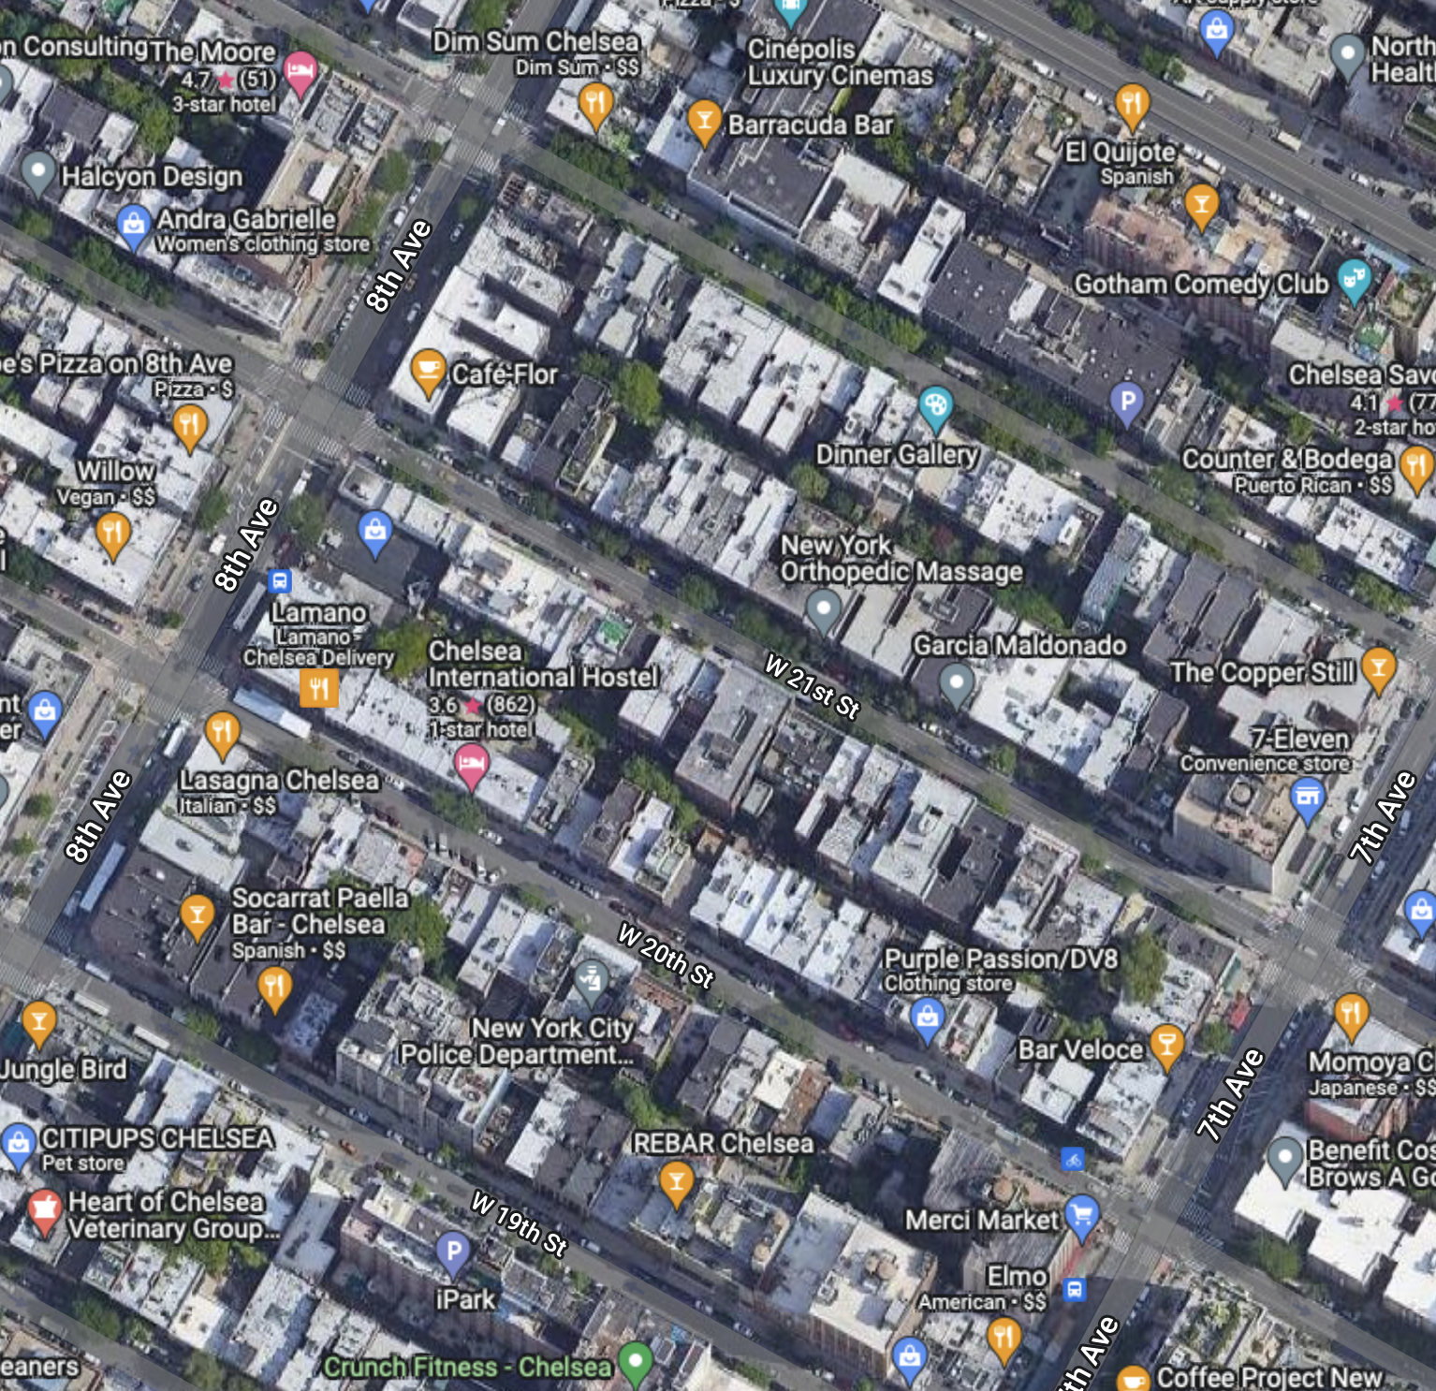
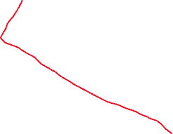
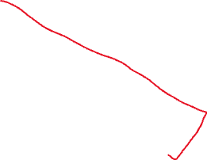
Extreme Disaggregation
90
Individua Data Points

Slide 22


Extreme Disaggregation
Approach: divide the city block into smaller target regions and then train a model to disaggregate the block value.
At the extreme situation, where the target regions are small enough, each target region contains only one taxi trip.
Incorporate prior knowledge into constructing the smaller target regions.

Slide 23
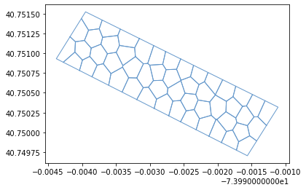
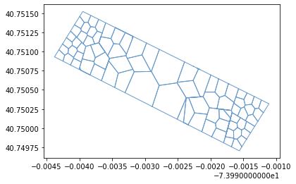
Extreme Disaggregation
Evenly distributed target regions
Unevenly distributed target regions
More precise on east & west sides

Slide 24
Extreme Disaggregation
Evenly distributed target regions
Unevenly distributed target regions
More precise on east & west sides

Slide 25
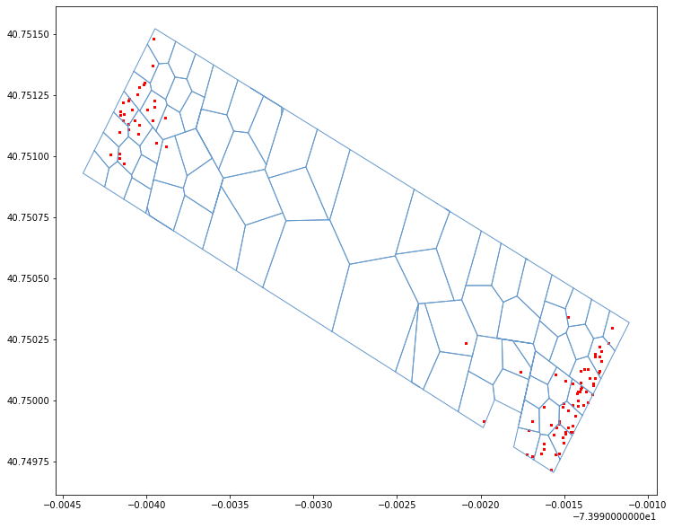
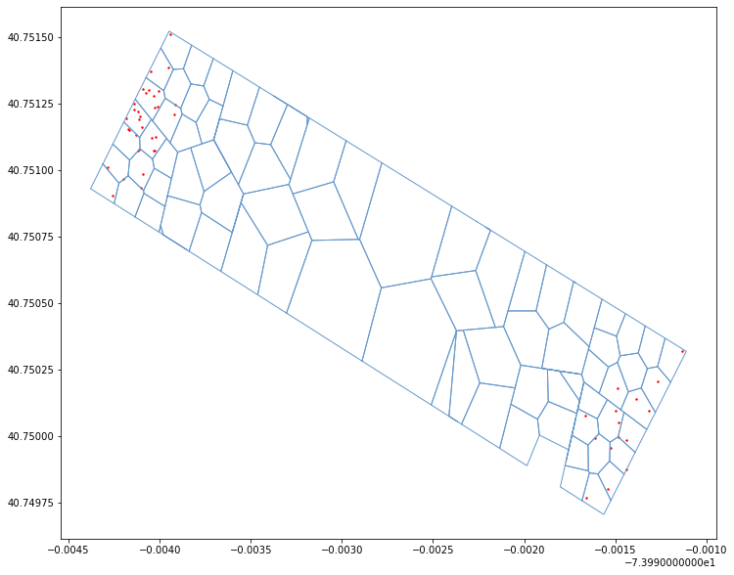
Extreme Disaggregation – Results
06/30/2016, 11pm-12am, real taxi trips
06/30/2016, 11pm-12am, generated taxi trips

Slide 26
Data Fusion
We have the privilege of having abundant urban data to train large, complex and powerful models, while, we usually do not have large amount of data in reality.
Urban data that are collected at the same geospatial level share the same spatial structure. When data is limited, we can incorporate other urban data to assist the model training.
Assumption:
- Adding other urban data benefits model training.
- GAN incorporate the connections among spatial units, thus benefiting more than other baseline models.

Slide 27
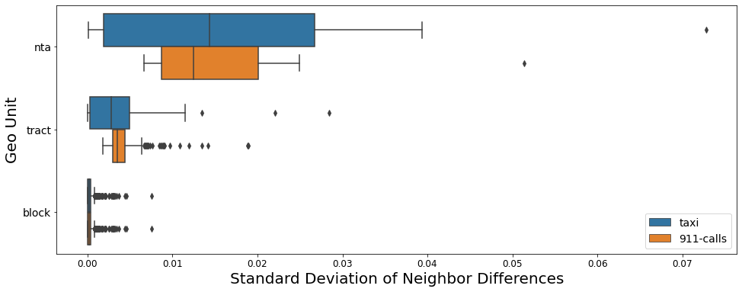
Data Fusion – Datasets
Testing Data:
2015 & 2016 NYC hourly taxi trip counts (only use 1% training data)
Supplementary Data:
2019 NYC hourly 911 calls
Four spatial levels: PUMA, NTA, Tract, Block

Slide 28
Data Fusion – Results
PUMA - NTA
Model | Proportion of Supplementary Data
 | 0 | 10% | 50% | 100%
NN | 43.96767 | 34.58375 | 34.26782 | 32.78835
Adding other urban data benefits model training.
GAN model incorporates the connections among spatial units, thus benefiting more than other baseline models.

Slide 29
Thank you!

